Slide 1
TEENANGELS
Notes:
Welcome and introduction.
Teenangels is a group of thirteen to eighteen year old volunteers that have been specially trained in all aspects of online safety, privacy, and security. It was founded in 1999 by leading cyberlawyer Parry Aftab, Executive Director of WiredSafety.org, the world’s larges online safety and help organization.
The Teenangels training program is comprehensive and rigorous. Rather than just teaching teens to understand ways of keeping themselves safer online, this is a train-the-trainers program, with teens developing their own programs and designing safer technologies.

Slide 2
Why
Teenangels?
Notes:
As mentioned in the introduction, the Teenangels training program is a rigorous one (details will be discussed later).
So why become a Teenangel?
Show “Introduction to Teenangels” video.

Slide 3
Because
  I want to make a difference
Notes:
Because I want to make a difference
Teenangels
Let kids and parents know about the potential risks that exist online.
They go to schools and educate children and teachers about Internet safety.
Teens know what teens are doing online
Teens will take advise from other teens more readily than they will from adults
Discuss
Ways you feel you have made a difference.
Have spoken to hundreds of students in New York, New Jersey, and Pennsylvania about cyberbullying and Internet safety.
Let them know the many activities that constitute cyberbullying
Empower them with strategies to keep themselves from being cyberbullied or becoming cyberbullies
“Google yourself,” and for younger kids “Stop, Block and Tell” and “Take 5!”
Created the Megan Pledge Program in memory of Megan Meier who committed suicide as a result of being cyberbullied.
The goal of the pledge program is to encourage students to take a stand against cyberbullying.
About 300, 000 students have take the pledge online.
Katie Dempsey
NYCyber Safety Summit 2008 - Hosted by the New York City Council
During the daylong event, the Teenangels participated in peer discussion sessions, spoke to groups of middle school and high school students about the kinds of activities that constitute cyberbullying, shared concrete suggestions aimed to empower students to stop cyberbullying, and explained and promoted the Megan Pledge program which encourages teens and pre-teens to “take a stand” against cyberbullying.

Slide 4
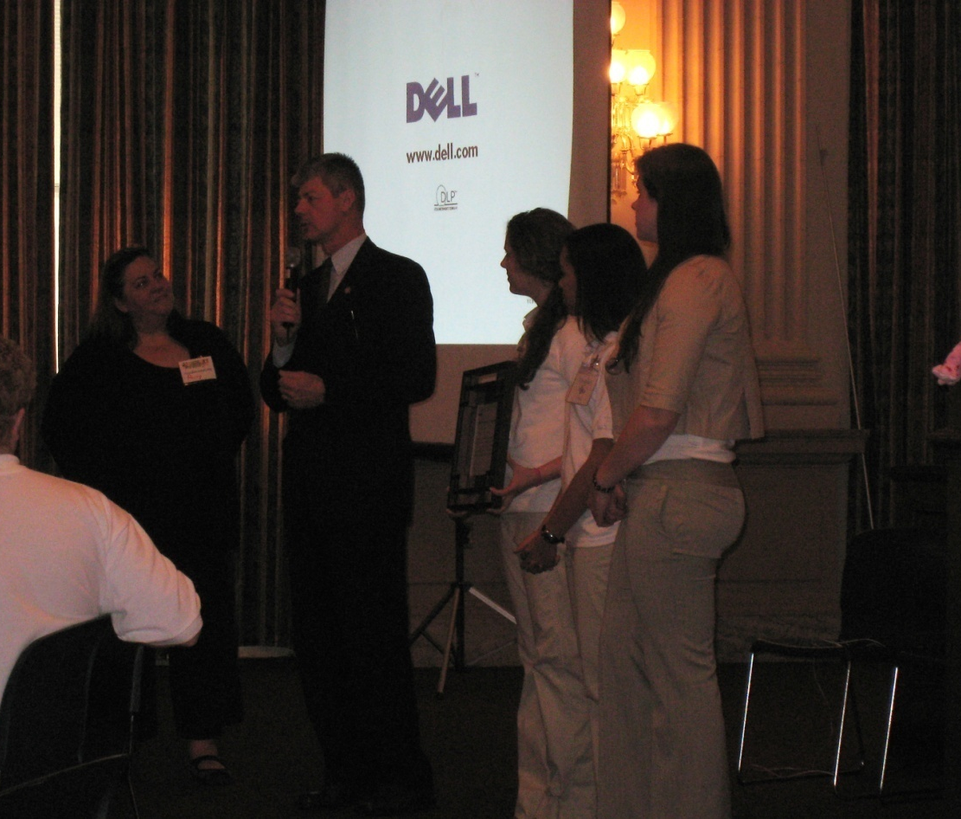
Because
  I get to work with companies like Microsoft, McAfee, AOL, Procter & Gamble, Verizon and Facebook
Notes:
Because
I want to work with companies like Microsoft, McAfee, AOL, Procter & Gamble and Facebook
Teenangels advise the technology industry and provide content such companies as Verizon, Disney and AOL
Katie Dempsey, Gianna Caiola, Stephanie
Discuss P&G partnership
Partnership with Proctor & Gamble
Teenangels contribute articles for the Online Safety page of beinggirl.com.
They answer questions posted by site visitors.

Slide 5
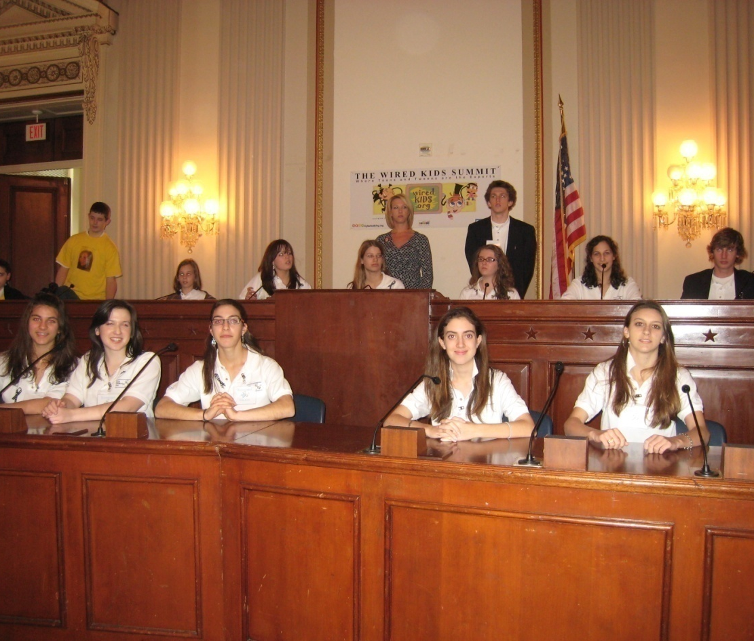
Because
  I want to be heard
Notes:
Because I want to be heard
Teenangels provide the teen perspective on cyber issues at various events and conferences around the country.
Each year a WiredKids Summit is held in Washington, DC
At the summit, Teenangels present their research to representatives of technology companies, the media, government agencies and law enforcement. They provide the teen perspective on what teens are doing online and how to keep them safer.
Discuss
Your experience at the 2008 summit.
Ex. Spoke to Chief Privacy Officers of Facebook and Myspace
Casi
2008 Cyber Safe California Summit
Participated in panel “Internet Safety: What Kids Know – and You Don’t”
Summit attendees included Chief Information Security Officer for the State of California, Deputy Attorney General California, Chief Privacy Strategist from M
Microsoft, California Secretary of Education and Special Agent from the FBI.
Casi , Stephanie
2007 National Coalition of Girls’ Schools Annual Conference
Conducted an online safety discussion group for administrators of girls’ schools.
Fielded questions relating to effective blocking practices at schools, student involvement in the development of acceptable use policies, safety issues related to cell phone use and social networking sites.

Slide 6
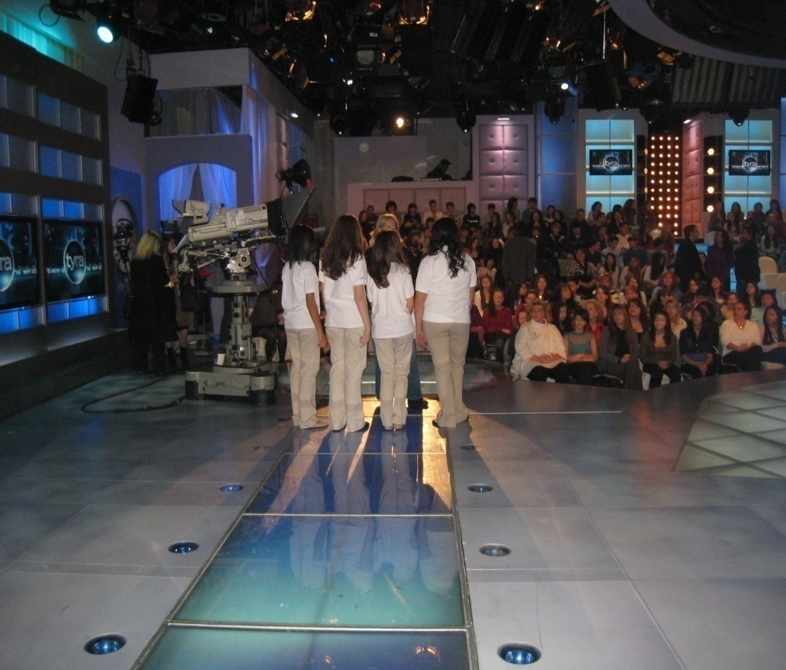
Because
  I want to see myself on TV
Notes:
Because
I want to see myself on TV
Discuss
Tyra Banks Show
Introduced the Megan Pledge Program
Members of the chapter have appeared on WCBS-TV, RNN-TV (Channel 6 in Westchester) and MY9 – TV.
They were part of a documentary for PBS that will air next Fall.
Casi & Stephanie
WCBS-TV interview – Cindy Hsu
“Local Teens Take a Stand Against Cyberbullying” – Nov 20th 2008

Slide 7
Because
  I want the media to turn to me for answers
    Chicago Tribune
    BBC News Online
    Catholic New York
    Forbes.com
    WCBS-TV
    RNN-TV
Notes:
Because I want the media to turn to me for answers
Discuss
Members of our chapter have been interviewed by WCBS-TV, RNN-TV (Channel 6 Westchester), BBC News Online, Catholic New York, Forbes.com, Chicago Tribune and others.
Amanda
Chicago Tribune
“Billion-dollar battle: Viacom vs. YouTube” – March 14, 2007
Gianna Caiola, Katie Dempsey, Stephanie, Casi, Maggie Patterson
RNN-TV The Richard French Live Show (Channel 6 in Westchester)
“The Bullying Epidemic”
Casi
BBC News Online
“Battling the Online Bullies” – June 27, 2008 (At Stop Cyberbullying Conference)
Casi, Stephanie
Catholic New York
“Teenangels – Ursuline students teaching others to use Internet safely” – March 13, 2008
Maggie Patterson
Forbes.com
“The state of Cybersecurity – Making Social Sites Safer” – May 14, 2008
Casi & Stephanie (mentioned on prior slide)
WCBS-TV interview – Cindy Hsu
“Local Teens Take a Stand Against Cyberbullying” – Nov 20th 2008

Slide 8
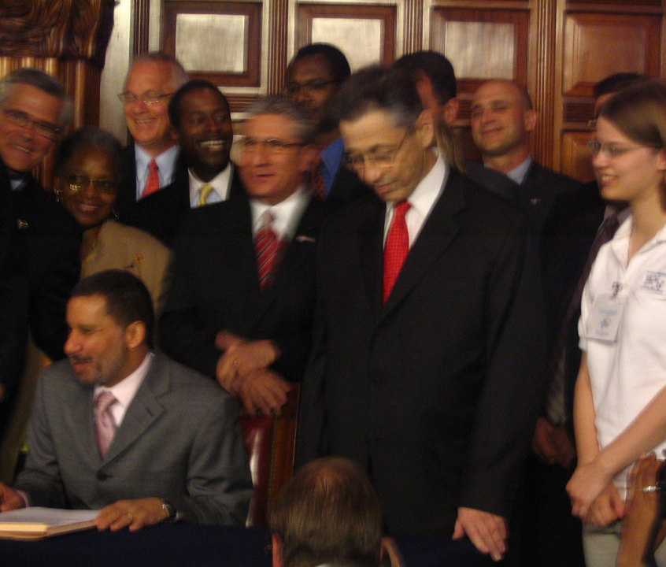
Because
  I want to meet governors, congressmen and other policy makers
Notes:
Because
I want to meet governors, congressmen and other policy makers
Maggie P.
Represented the Teenangels at the signing of the Electronic Security and Targeting of Online Predators (e-STOP) Act. (Goal of e-STOP bill is to help identify convicted sexual predators and restrict their access to websites frequented by children and teens)
Casi, Stephanie, Maggie P
Attended a meeting of the Internet Safety Technical Task Force (ISTTF) hosted by Harvard’s Berkmann Center for Internet & society.
Presented their research on cyberbullying and teen use of social networking sites and provided the youth perspective on the issues being discussed by the task force

Slide 9
Because
  I want colleges to look for me
Notes:
Because
I want colleges to look for me
Discuss your Teenangels portfolio and college interviews.

Slide 10
Because
I want to change my life
Notes:
Because
I want to change my life
Discuss
Ways Teenangels has changed your life.
Skills you have picked up in the program

Slide 11
Because
I want to change my world
Notes:
Because
I want to change my world
Discuss
Ways you feel Teenangels has enabled you to change your world.

Slide 12
Because
I want to be part of the solution
Notes:
Because
I want to be part of the solution.

Slide 13
HOW DO I BECOME A TEENANGEL?

Slide 14
Start a Chapter
Find faculty members to serve as
  Chapter director
  Assistant chapter director
Send Teenangels application to teenangels.org a division of wiredsafety.org
  13 – 18 years old
Notes:
Start a chapter

Slide 15
Begin Training
12 training modules
  up to 3 classes each
2 independent research projects
  1st project on technology devices or sites
  2nd project on behaviors
2 presentations to student groups
1 presentation to a parent or community group
Notes:
The Teenangels Training Program consists of
12 online training modules
up to 3 classes each
2 independent research projects
1st project on technology devices or sites
2nd project on behaviors
2 presentations to student groups
1 presentation to a parent or community group
Our experience has been that training takes about 1 school year to complete.
Each year Teenangels are in the program, they are required to
continue doing research and
making presentations to student and parent groups.
As new issues develop in technology, they address them using their basic training a additional targeted training.

Slide 16
ARE YOU READY FOR A CHALLENGE?
Notes:
Thank you for your attention.
Any questions?

